Slide 1
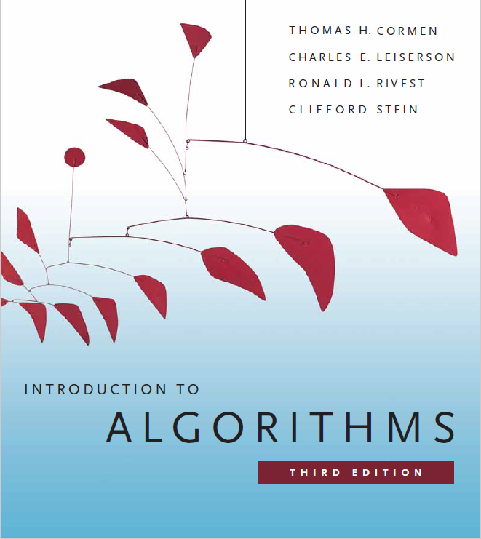
Dynamic Programming
Prepared by Shmuel Wimer
Instructed by Deganit Armon and Shmuel Wimer

Slide 2

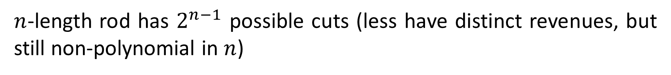
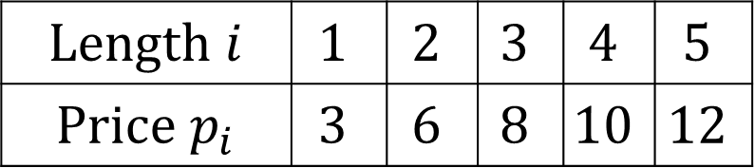


Rod Cutting Optimization
$\text{Length}$ $i$ | $$1$$ | $$2$$ | $$3$$ | $$4$$ | $$5$$
$\text{Price}$ $p_{i}$ | $$3$$ | $$6$$ | $$8$$ | $$10$$ | $$12$$
$$r=3+10=13$$
$$r=6+8=14$$
$$r=3+6+6=15$$
What cut maximizes revenue $r_{n}$?
$n$-length rod has $2^{n−1}$ possible cuts (less have distinct revenues, but still non-polynomial in $n$)

Slide 3
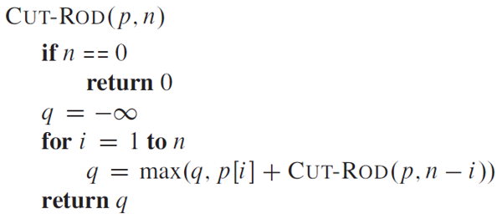
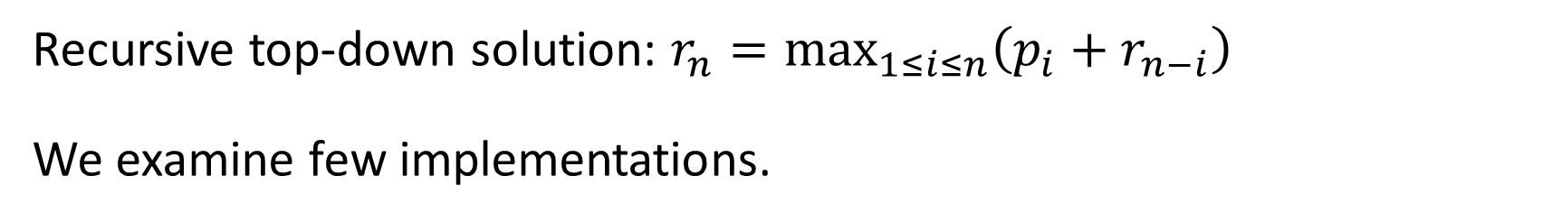
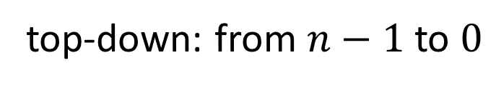
Recursive top-down solution: $r_{n}={\text{max}}_{1≤i≤n}\left(p_{i}+r_{n−i}\right)$
We examine few implementations.
top-down: from $n−1$ to $0$
Very inefficient! CUT-ROD calls itself recursively again and again with same parameter values.

Slide 4
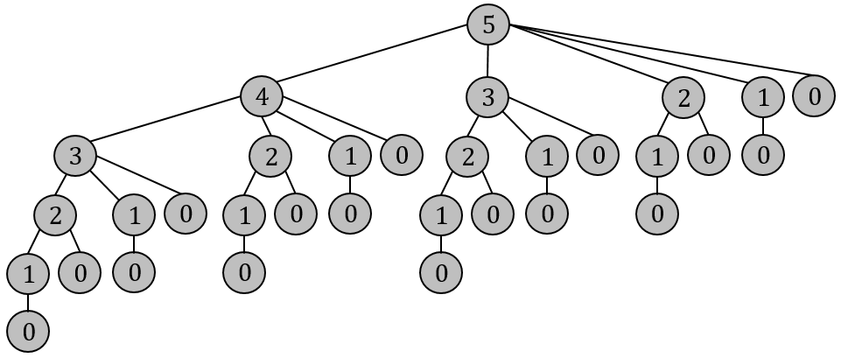
Recursion tree nodes: sub-problem size resulting from $\text{CUT}\text{−}\text{ROD}(p,5)$.
Same sub-problems solved many times!
left over rod size

Slide 5
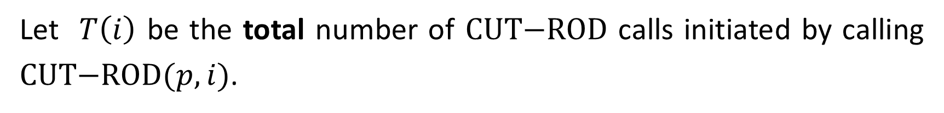
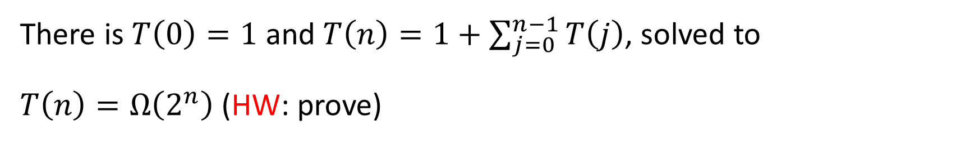
Let $T\left(i\right)$ be the total number of $\text{CUT}\text{−}\text{ROD}$ calls initiated by calling $\text{CUT}\text{−}\text{ROD}(p,i)$.
call at root
There is $T\left(0\right)=1$ and $T\left(n\right)=1+\sum_{j=0}^{n−1}{T\left(j\right)}$, solved to
$T\left(n\right)=Ω\left(2^{n}\right)$ (HW: prove)
Repetitions of same sub-problems can be avoided by memoization.

Slide 6
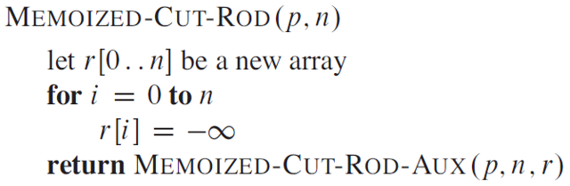
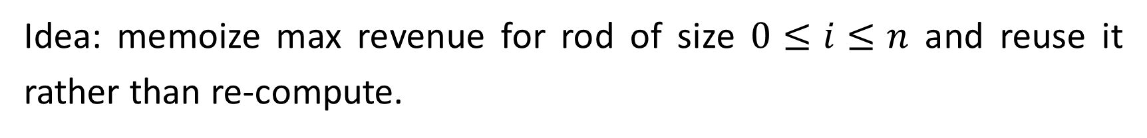
Top-down Solution by Dynamic Programming
Idea: memoize max revenue for rod of size $0≤i≤n$ and reuse it rather than re-compute.
// init revenues of sub-problems

Slide 7
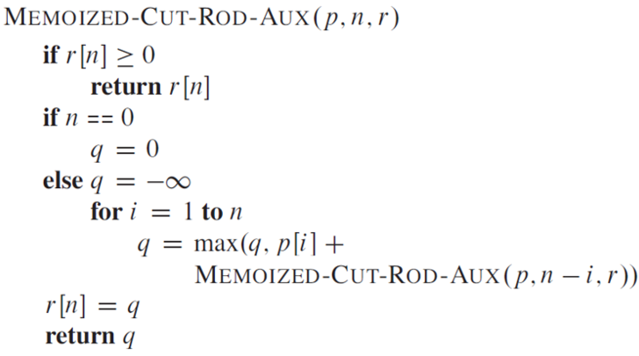
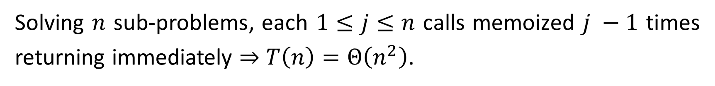
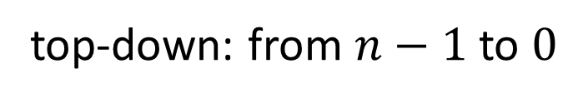
// avoid repetition of sub-problems
// use memoized solution
// empty problem yields zero revenue
// solve all 1 to n sub-problems
// choose the best of two
// memoize solution
top-down: from $n−1$ to $0$
Solving $n$ sub-problems, each $1≤j≤n$ calls memoized $j −1$ times returning immediately $⇒$ $T\left(n\right)=Θ\left(n^{2}\right)$.

Slide 8
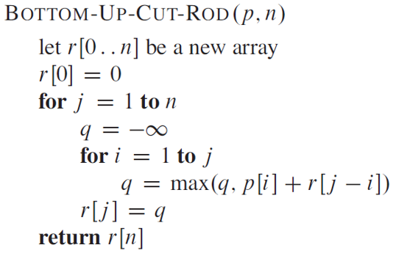
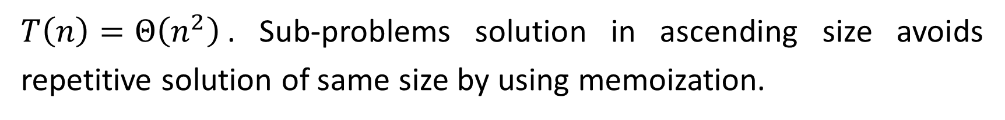
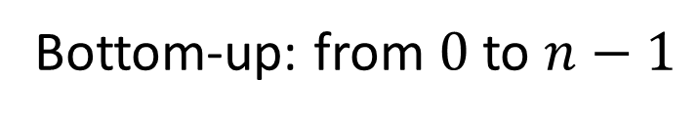
Bottom-up Solution by Dynamic Programming
// max revenue memoization array
Bottom-up: from $0$ to $n−1$
// update max cost
// memoize max revenue
$T\left(n\right)=Θ\left(n^{2}\right)$. Sub-problems solution in ascending size avoids repetitive solution of same size by using memoization.

Slide 9
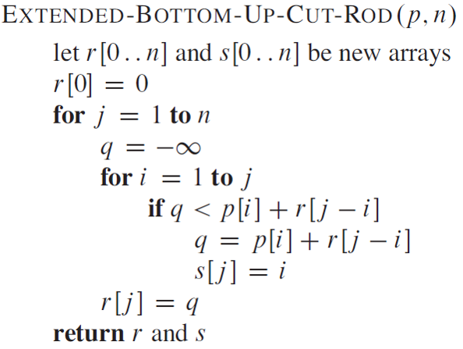
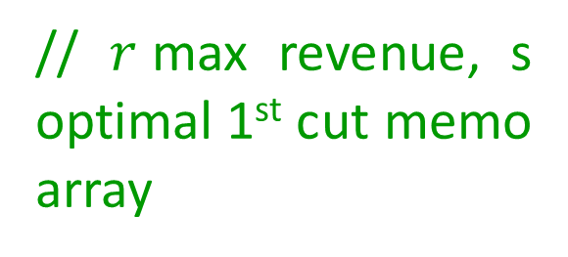
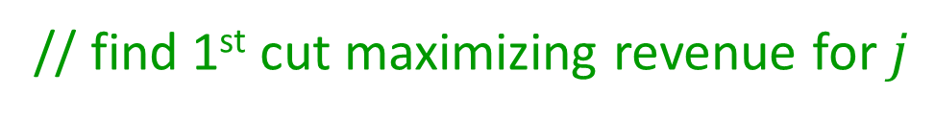
Cut Retrieval of Optimal Solution
// $r$max revenue, s optimal 1st cut memo array
// init max revenue
// find 1st cut maximizing revenue for $j$
// is better cut found
// update max revenue
// record where optimal 1st cut occurs
// memoize max revenue

Slide 10
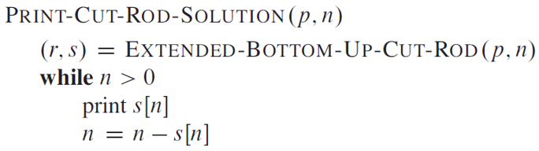
Max revenue cuts is retrieved by backward traversal
// get first cut of max revenue solution
// size of next (smaller) sub-problem

Slide 11
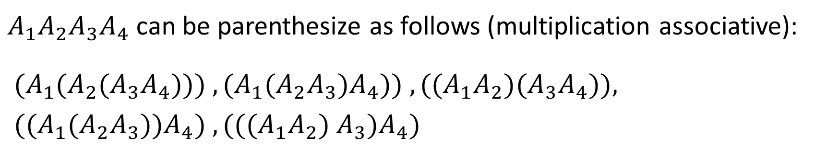
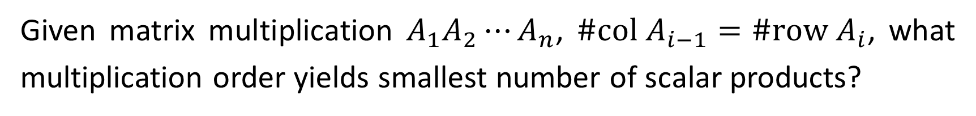
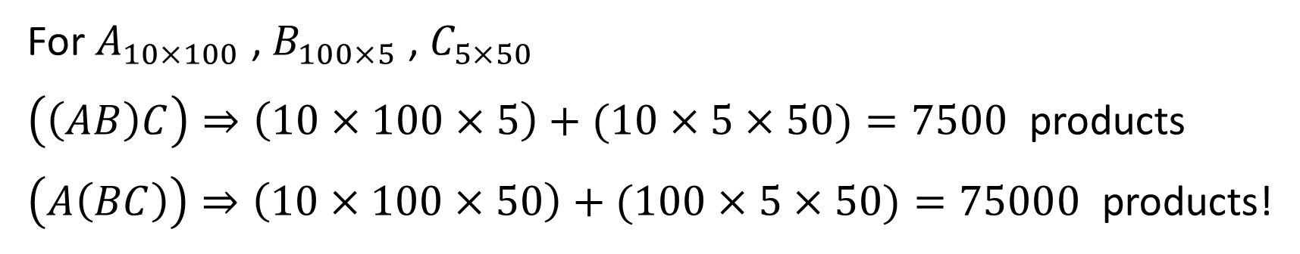
Optimal Matrix-Chain Multiplication
Given matrix multiplication $A_{1}A_{2}⋯A_{n}$, $\#\text{col} A_{i−1}=\#\text{row} A_{i}$, what multiplication order yields smallest number of scalar products?
$A_{1}A_{2}A_{3}A_{4}$ can be parenthesize as follows (multiplication associative):
${(A}_{1}(A_{2}{(A}_{3}A_{4}))) , {(A}_{1}(A_{2}A_{3})A_{4})) , {((A}_{1}A_{2}{)(A}_{3}A_{4})),$
${((A}_{1}(A_{2}A_{3}))A_{4}) , {(((A}_{1}A_{2}{) A}_{3})A_{4})$
For $A_{10×100}$ , $B_{100×5}$ , $C_{5×50}$
$\left(\left(AB\right)C\right)⇒\left(10×100×5\right)+(10×5×50)=7500$ products
$\left(A\left(BC\right)\right)⇒\left(10×100×50\right)+(100×5×50)=75000$ products!

Slide 12
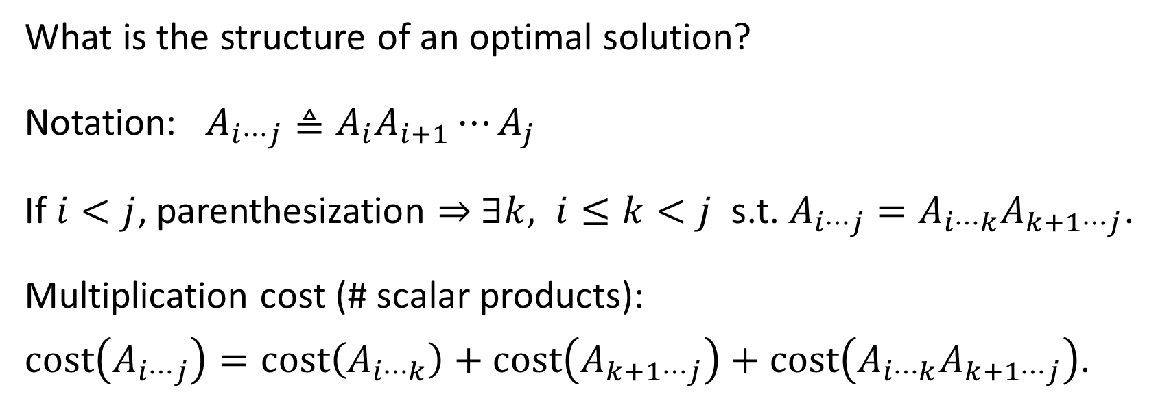
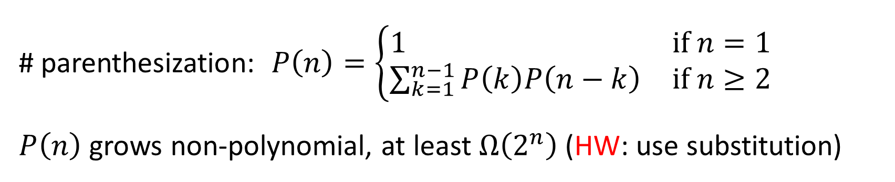
# parenthesization: $P\left(n\right)=\left\{\begin{matrix}1 & \text{if} n=1 \\ \sum_{k=1}^{n−1}{P\left(k\right)P\left(n−k\right)} & \text{if} n≥2\end{matrix}\right.$
$P\left(n\right)$ grows non-polynomial, at least $Ω\left(2^{n}\right)$ (HW: use substitution)
What is the structure of an optimal solution?
Notation: $A_{i⋯j}≜A_{i}A_{i+1}⋯A_{j}$
If $i<j$, parenthesization ⇒ $∃k, i≤k<j$ s.t. $A_{i⋯j}=A_{i⋯k}A_{k+1⋯j}$.
Multiplication cost (# scalar products):
$\text{cost}\left(A_{i⋯j}\right)=\text{cost}\left(A_{i⋯k}\right)+\text{cost}\left(A_{k+1⋯j}\right)+\text{cost}\left(A_{i⋯k}A_{k+1⋯j}\right)$.

Slide 13
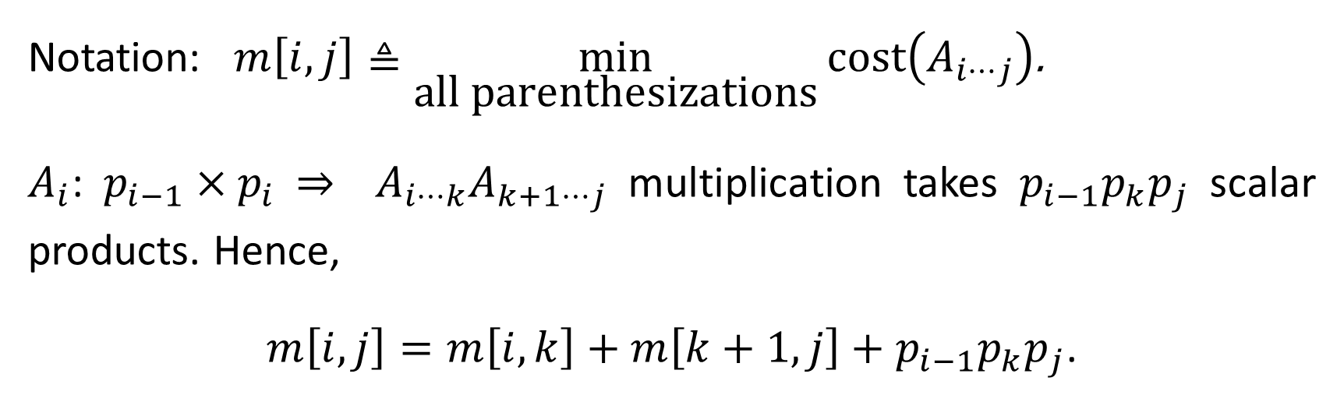
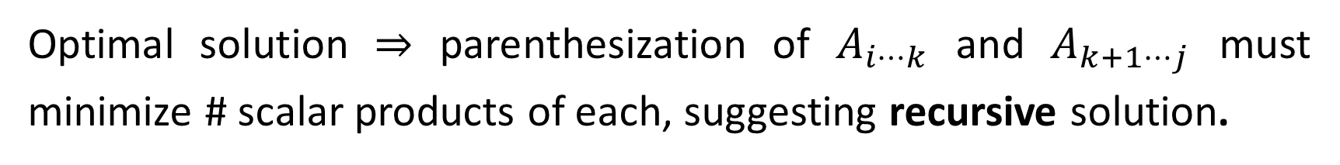
Optimal solution ⇒ parenthesization of $A_{i⋯k}$ and $A_{k+1⋯j}$ must minimize # scalar products of each, suggesting recursive solution.
Notation: $m\left[i,j\right]≜\min_{\text{all} \text{parenthesizations}}{\text{cost}\left(A_{i⋯j}\right)}$.
$A_{i}$: $p_{i−1}×p_{i}$ ⇒ $A_{i⋯k}A_{k+1⋯j}$ multiplication takes $p_{i−1}p_{k}p_{j}$ scalar products. Hence,
$m\left[i,j\right]=m\left[i,k\right]+m\left[k+1,j\right]+p_{i−1}p_{k}p_{j}$.

Slide 14
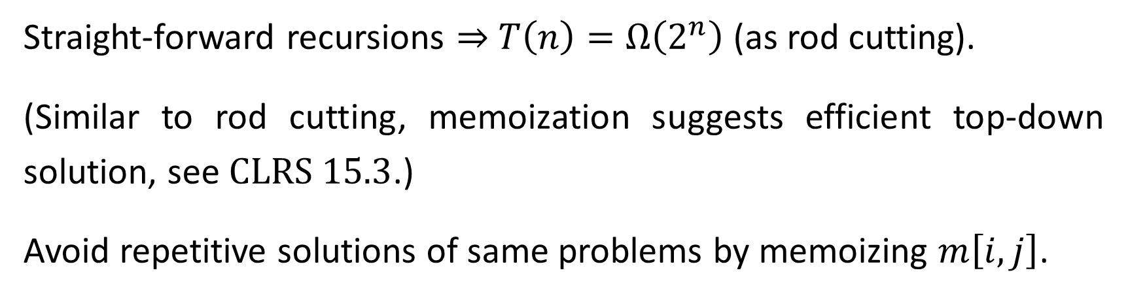
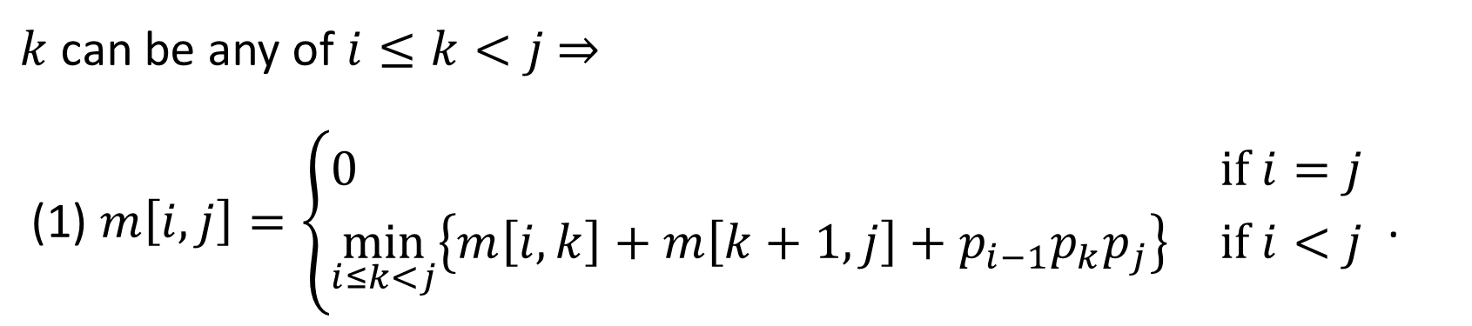
$k$ can be any of $i≤k<j$ ⇒
(1) $m\left[i,j\right]=\left\{\begin{matrix}0 & \text{if} i=j \\ \min_{i≤k<j}\left\{m\left[i,k\right]+m\left[k+1,j\right]+p_{i−1}p_{k}p_{j}\right\} & \text{if} i<j\end{matrix}\right.$ .
Straight-forward recursions ⇒ $T\left(n\right)=Ω\left(2^{n}\right)$ (as rod cutting).
(Similar to rod cutting, memoization suggests efficient top-down solution, see $\text{CLRS}\text{ 15.3}$.)
Avoid repetitive solutions of same problems by memoizing $m\left[i,j\right]$.

Slide 15
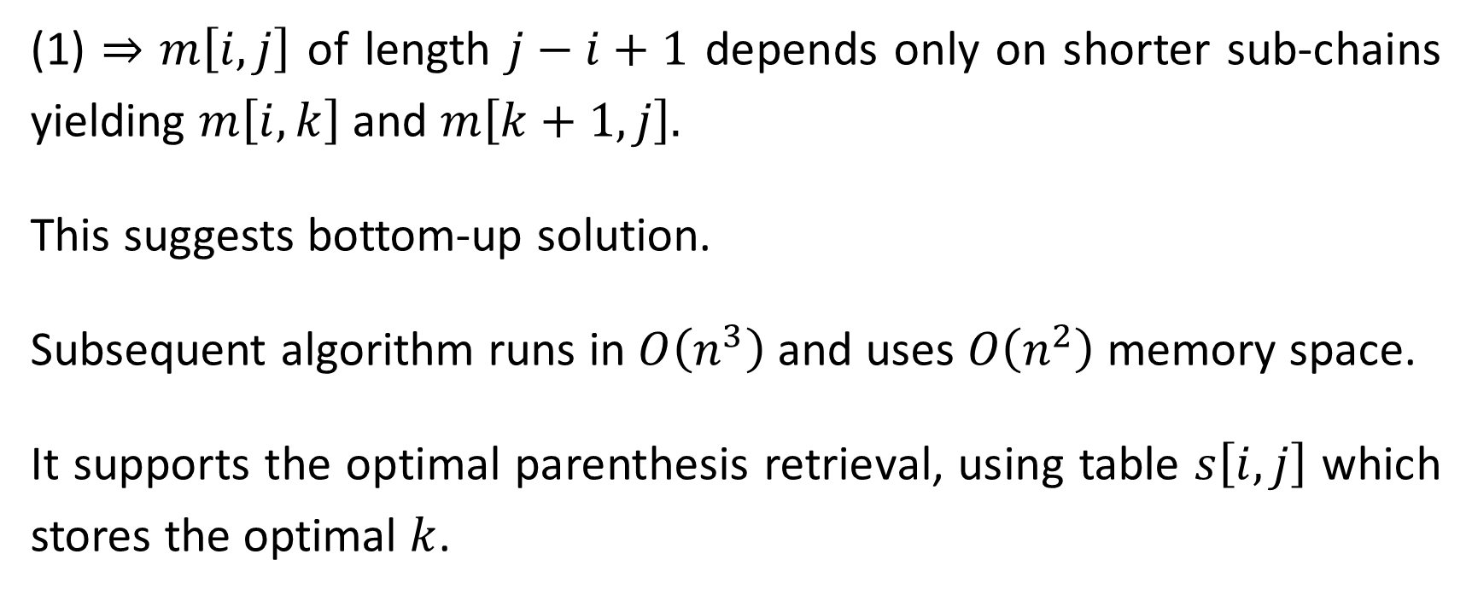
(1) ⇒ $m\left[i,j\right]$ of length $j−i+1$ depends only on shorter sub-chains yielding $m\left[i,k\right]$ and $m\left[k+1,j\right].$
This suggests bottom-up solution.
Subsequent algorithm runs in $O\left(n^{3}\right)$ and uses $O\left(n^{2}\right)$ memory space.
It supports the optimal parenthesis retrieval, using table $s\left[i,j\right]$ which stores the optimal $k$.

Slide 16
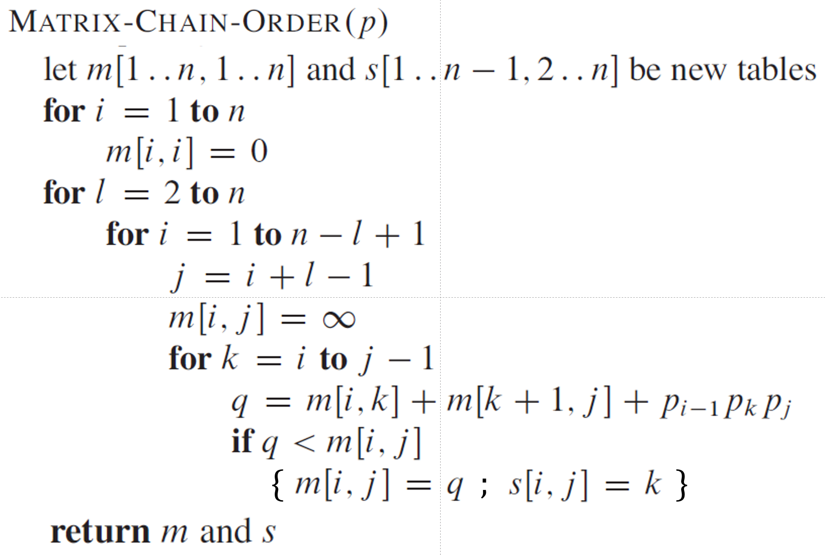
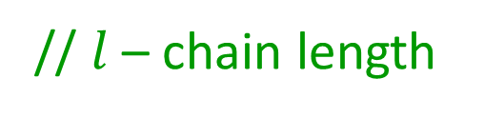
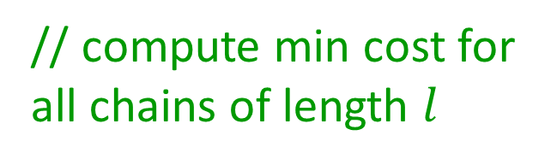

$$\left(p,n\right)$$
// no multiplication in length 1 chain, zero cost
// $l$ – chain length
// compute min cost for all chains of length $l$
// init chain min cost
// set chain split border
// update chain’s min cost and split

Slide 17
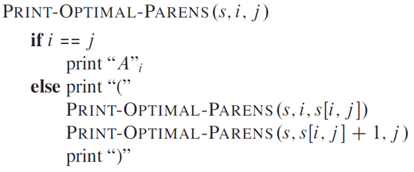
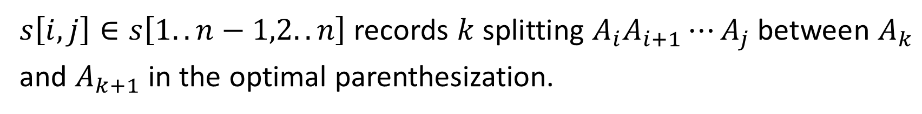
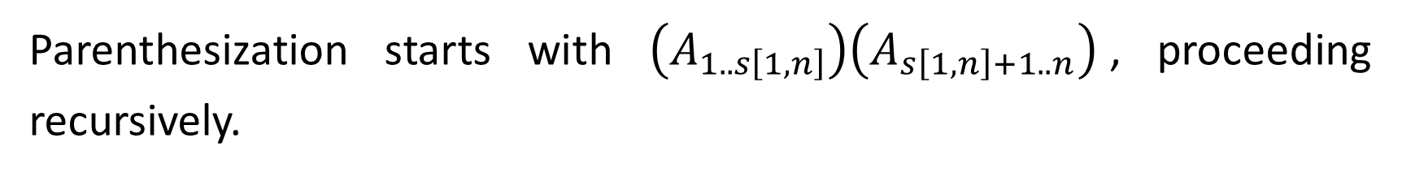
Retrieval of Optimal Parenthesization
$s\left[i,j\right]∈s\left[1..n−1,2..n\right]$ records $k$splitting $A_{i}A_{i+1}⋯A_{j}$ between $A_{k}$ and $A_{k+1}$ in the optimal parenthesization.
Parenthesization starts with $\left(A_{1..s\left[1,n\right]}\right)\left(A_{s\left[1,n\right]+1..n}\right)$, proceeding recursively.

Slide 18
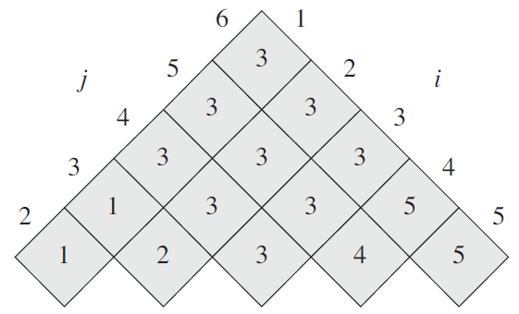

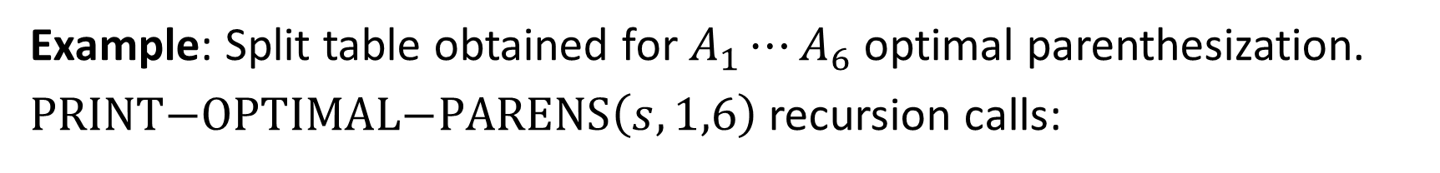






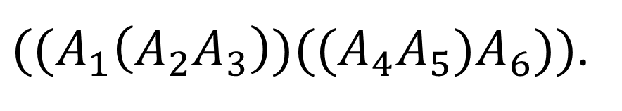

Example: Split table obtained for $A_{1}⋯A_{6}$ optimal parenthesization.
$\text{PRINT}\text{−}\text{OPTIMAL}\text{−}\text{PARENS}\left(s,1,6\right)$ recursion calls:
$$\left(1,6\right)$$
$$\left(1,3\right)$$
$$\left(4,6\right)$$
$$\left(2,3\right)$$
$$\left(4,5\right)$$
$$\left(1,1\right)$$
$$\left(2,2\right)$$
$$\left(3,3\right)$$
$((A_{1}\left(A_{2}A_{3}\right))((A_{4}A_{5})A_{6}))$.

Slide 19
Dynamic Programming comprises:
Optimal sub-structures
Overlapping sub-problems
Reconstruction of optimal solution
Memoization

Slide 20
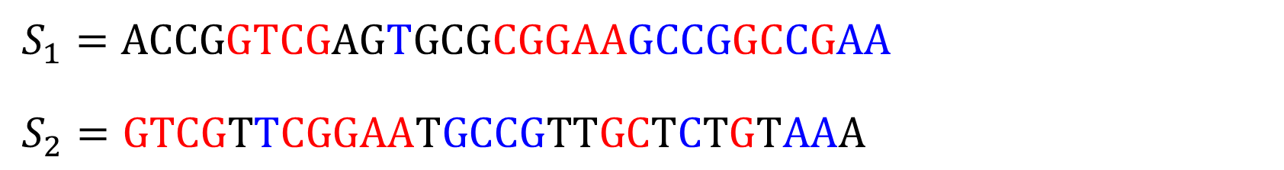
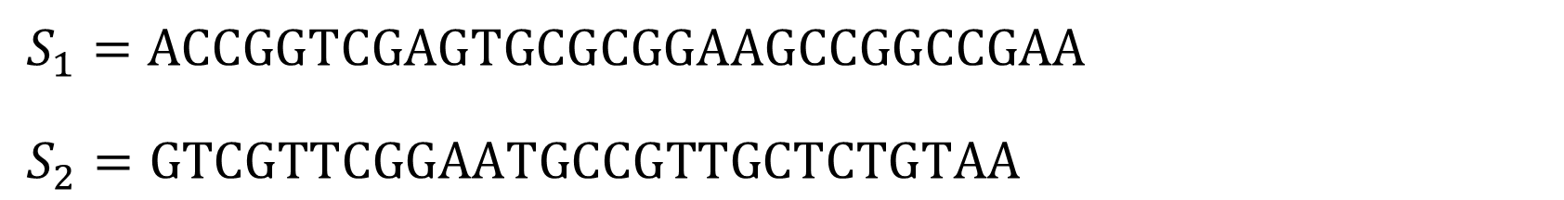
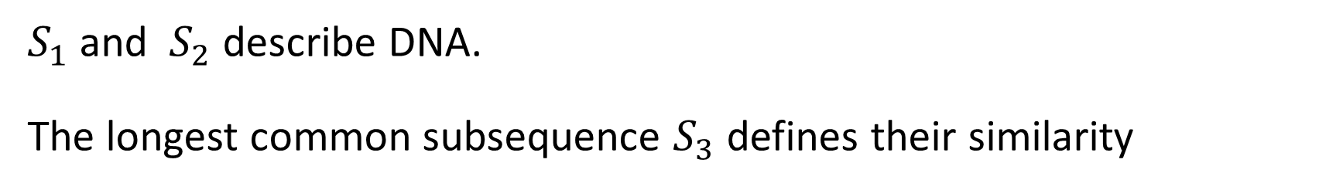
Longest Common Subsequence (LCS)
$S_{1}=ACCGGTCGAGTGCGCGGAAGCCGGCCGAA$
$S_{2}=\text{GTCGTTCGGAATGCCGTTGCTCTGTAA}$
$S_{1}$ and $S_{2}$ describe DNA.
The longest common subsequence $S_{3}$ defines their similarity
$S_{1}=ACCGGTCGAGTGCGCGGAAGCCGGCCGAA$
$S_{2}=\text{GTCG}\text{T}\text{T}\text{CGGAA}\text{T}\text{GCCG}\text{TT}\text{GC}\text{T}\text{C}\text{T}\text{G}\text{T}\text{AA}\text{A}$
$S_{3}=\text{GTCG}\text{T}\text{CGGAA}\text{GCCG}\text{GC}\text{C}\text{G}\text{AA}$

Slide 21
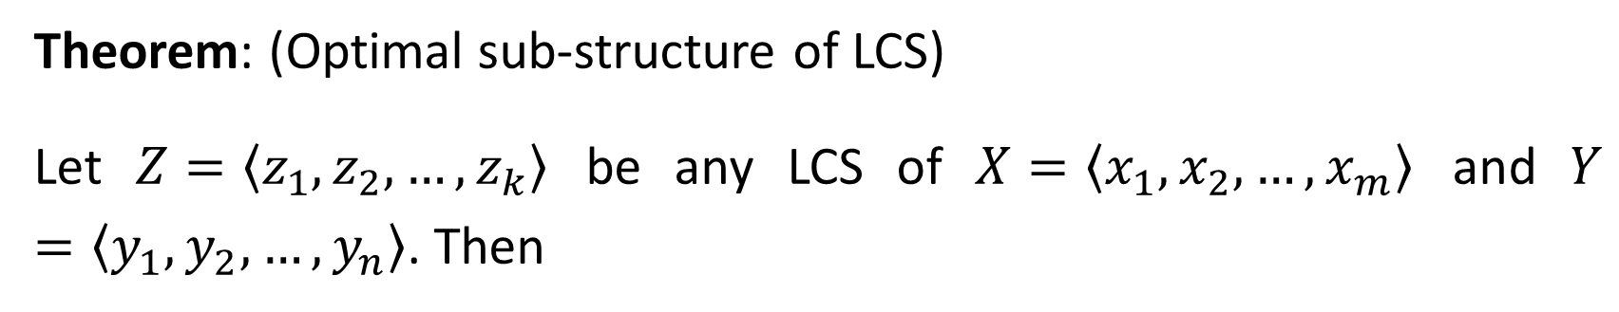
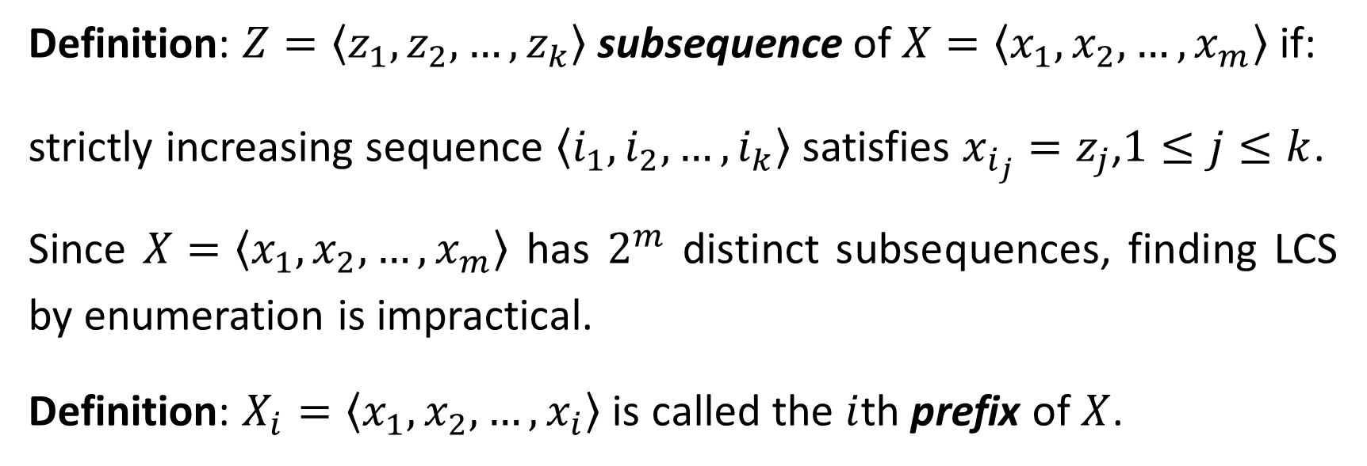
Definition: $Z=\left\langle z_{1},z_{2},…,z_{k}\right\rangle$ subsequence of $X=\left\langle x_{1},x_{2},…,x_{m}\right\rangle$ if:
strictly increasing sequence $\left\langle i_{1},i_{2},…,i_{k}\right\rangle$ satisfies $x_{i_{j}}=z_{j}$,$1≤j≤k$.
Since $X=\left\langle x_{1},x_{2},…,x_{m}\right\rangle$ has $2^{m}$ distinct subsequences, finding LCS by enumeration is impractical.
Definition: $X_{i}=\left\langle x_{1},x_{2},…,x_{i}\right\rangle$ is called the $i$th prefix of $X$.
Theorem: (Optimal sub-structure of LCS)
Let $Z=\left\langle z_{1},z_{2},…,z_{k}\right\rangle$ be any LCS of $X=\left\langle x_{1},x_{2},…,x_{m}\right\rangle$ and $Y=\left\langle y_{1},y_{2},…,y_{n}\right\rangle$. Then

Slide 22
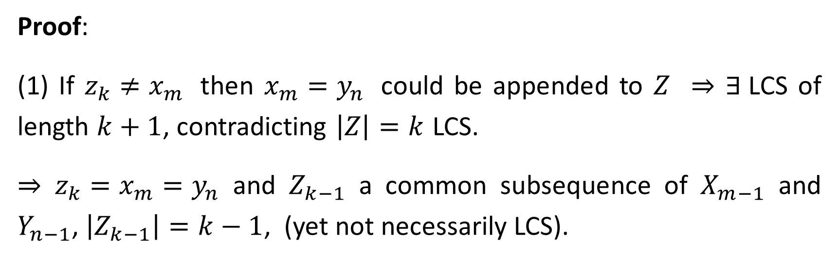
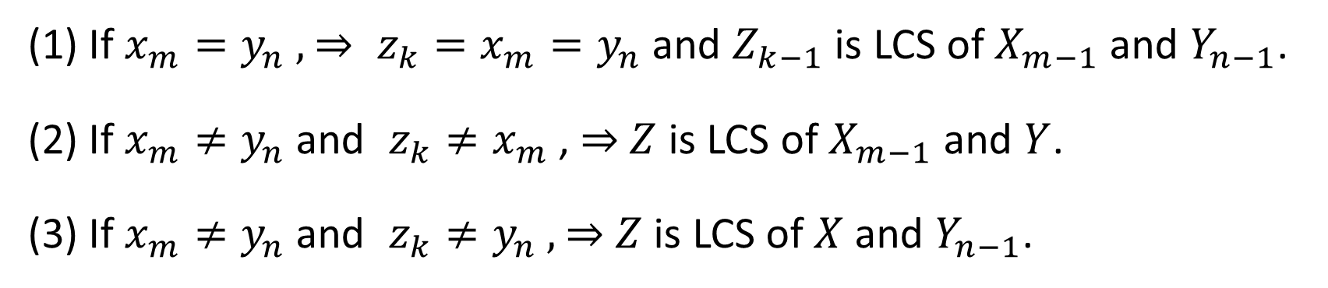
(1) If $x_{m}=y_{n}$ , ⇒ $z_{k}=x_{m}=y_{n}$ and $Z_{k−1}$ is LCS of $X_{m−1}$ and $Y_{n−1}$.
(2) If $x_{m}≠y_{n}$ and $z_{k}≠x_{m}$ , ⇒ $Z$ is LCS of $X_{m−1}$ and $Y$.
(3) If $x_{m}≠y_{n}$ and $z_{k}≠y_{n}$ , ⇒ $Z$ is LCS of $X$ and $Y_{n−1}$.
Proof:
(1) If $z_{k}≠x_{m}$ then $x_{m}=y_{n}$ could be appended to $Z$ ⇒ $∃$LCS of length $k+1$, contradicting $\left|Z\right|=k$ LCS.
⇒ $z_{k}=x_{m}=y_{n}$ and $Z_{k−1}$ a common subsequence of $X_{m−1}$ and $Y_{n−1}$, $\left|Z_{k−1}\right|=k−1$, (yet not necessarily LCS).

Slide 23
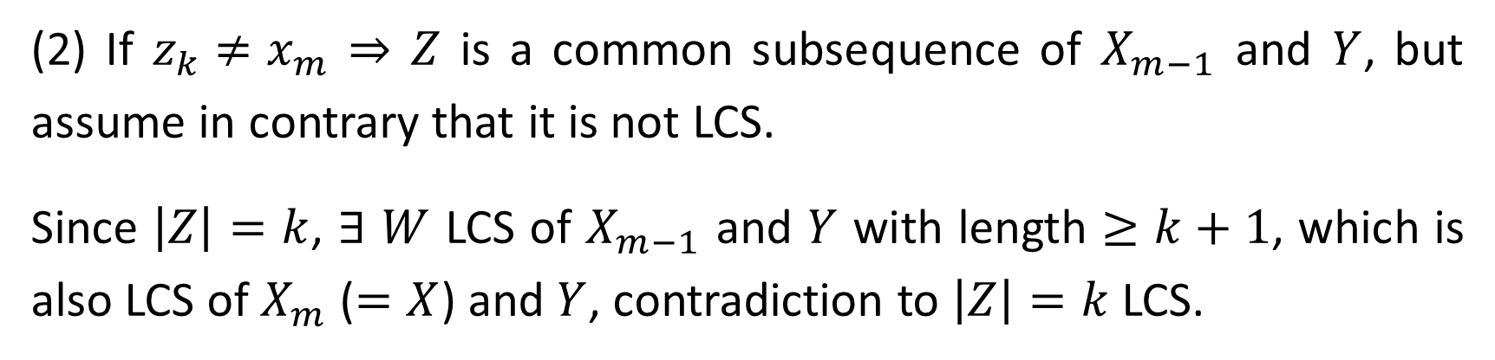
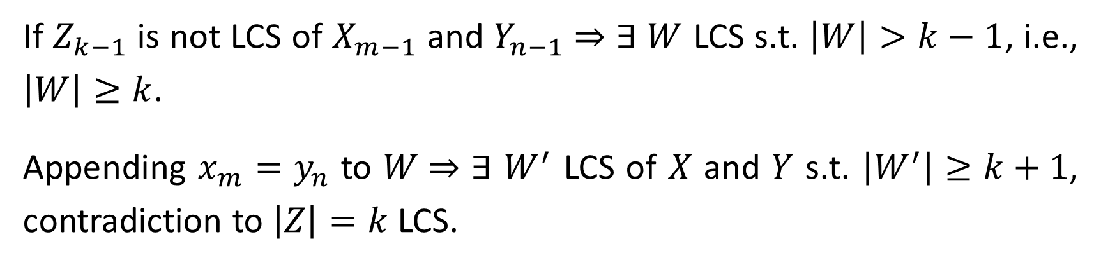
If $Z_{k−1}$ is not LCS of $X_{m−1}$ and $Y_{n−1}$ ⇒ $∃$ $W$ LCS s.t. $\left|W\right|>k−1$, i.e., $\left|W\right|≥k$.
Appending $x_{m}=y_{n}$ to $W$⇒ $∃$ $W^{′}$ LCS of $X$ and $Y$ s.t. $\left|W^{′}\right|≥k+1$, contradiction to $\left|Z\right|=k$ LCS.
(2) If $z_{k}≠x_{m}$ ⇒ $Z$ is a common subsequence of $X_{m−1}$ and $Y$, but assume in contrary that it is not LCS.
Since $\left|Z\right|=k$, $∃$ $W$ LCS of $X_{m−1}$ and $Y$ with length $≥$ $k+1$, which is also LCS of $X_{m}$ ($=X$) and $Y$, contradiction to $\left|Z\right|=k$ LCS.
(3) Symmetric to (2). $∎$

Slide 24
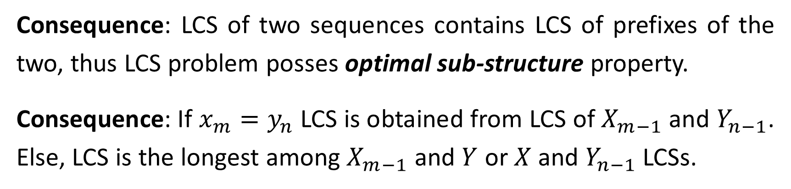

Consequence: LCS of two sequences contains LCS of prefixes of the two, thus LCS problem posses optimal sub-structure property.
Consequence: If $x_{m}=y_{n}$ LCS is obtained from LCS of $X_{m−1}$ and $Y_{n−1}$. Else, LCS is the longest among $X_{m−1}$ and $Y$ or $X$ and $Y_{n−1}$ LCSs.
Let $c\left[i,j\right]$ be the length of LCS of $X_{i}$ and $Y_{j}$, then
$$c\left[i,j\right]=\left\{\begin{matrix}0 & \text{if} i=0 \text{or} j=0, \\ c\left[i−1,j−1\right]+1 & \text{if} i,j>0 \text{and} x_{i}=y_{j}, \\ \text{max}\left(c\left[i,j−1\right],c\left[i−1,j\right]\right) & \text{if} i,j>0 \text{and} x_{i}≠y_{j}.\end{matrix}\right.$$

Slide 25

Straight-forward recursive implementation solves the problem, but same sub-problem may be solved few times.
HW: What is the worst-case input for the recursive solution?
However, only $\text{Θ}\left(mn\right)$ distinct LCS sub-problems exist, and bottom-up dynamic programming applies.

Slide 26



// $0$-length $X$ prefix
// $0$-length $Y$ prefix
// case (1) of theorem
// LCS growing
// case (2)
// LCS not growing
// case (3), LCS not growing

Slide 27

LCS Retrieval
The equation defining $c\left[i,j\right]$ enables LCS retrieval in reverse order.
Starting at $c\left[m,n\right]$, examination of $c\left[i−1,j−1\right]$, $c\left[i−1,j\right]$ and $c\left[i,j−1\right]$ determines how $c\left[i,j\right]$ was obtained.
LCS increases whenever $x_{i}=y_{j}$.
Note that LCS is not unique!
Q: Does the order of (2) and (3) in LCS-LENGTH matter?

Slide 28





$$j$$
$$\text{0}$$ | $$\text{1}$$ | $$\text{2}$$ | $$\text{3}$$ | $$\text{4}$$ | $$\text{5}$$ | $$\text{6}$$
$$i$$
$$y_{j}$$
B
 | D | C | A | B | A
0
1
2
3
4
5
6
7
$$x_{i}$$
A
B
C
B
D
A
B
0 | 0 | 0 | 0 | 0 | 0 | 0
0 | 0 | 0 | 0 | 1 | 1 | 1
0 | 1 | 1 | 1 | 1 | 2 | 2
0 | 1 | 1 | 2 | 2 | 2 | 2
0 | 1 | 1 | 2 | 2 | 3 | 3
0 | 1 | 2 | 2 | 2 | 3 | 3
0 | 1 | 2 | 2 | 3 | 3 | 4
0 | 1 | 2 | 2 | 3 | 4 | 4

